Slide 1

AI IN HEALTHCARE: LUNG DISEASE DETECTION WITH AI-POWERED GOOGLE TEACHABLE MACHINE

Slide 2

THE RISE OF AI IN HEALTHCARE
EASY
ADVANCED

Slide 3
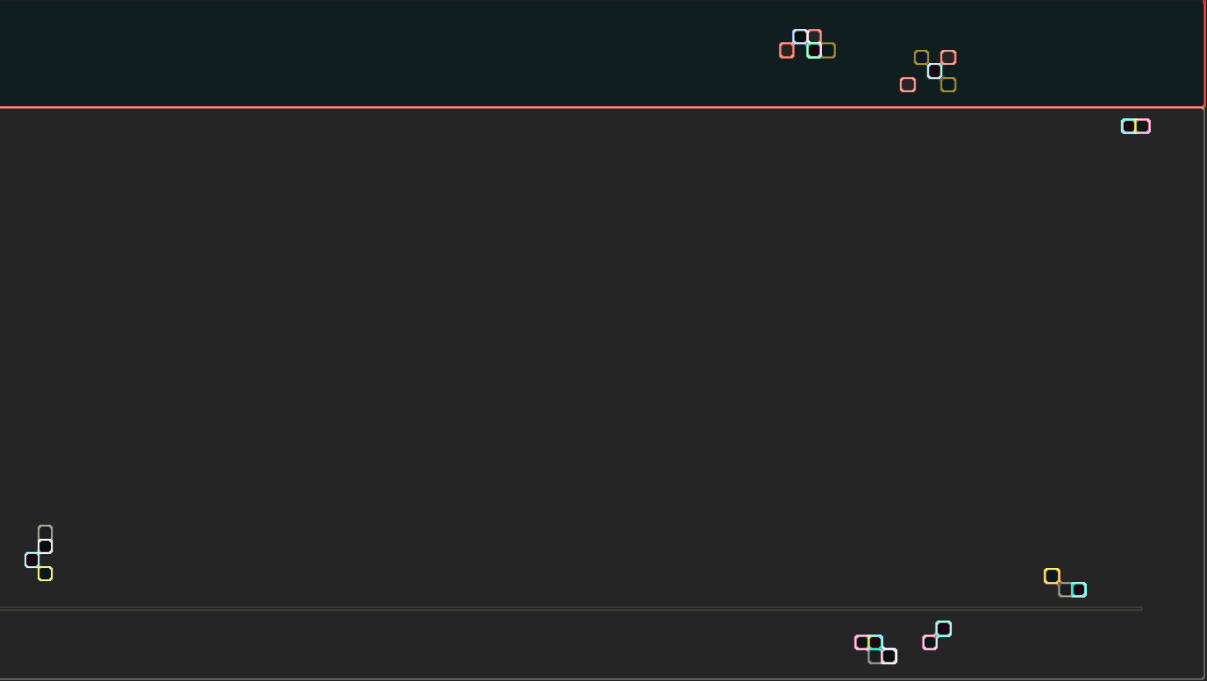
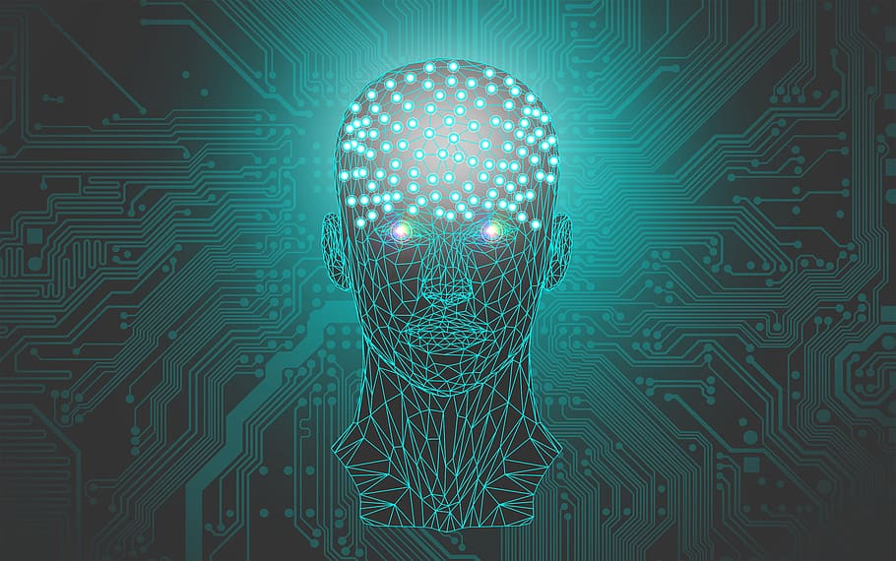
AI IN HEALTHCARE
AI is revolutionizing healthcare and medicine in many areas such as: (1) medical imagery and (2) drug research.
AI and more specifically Deep Learning has been proven to be superior to humans in detecting and classifying several diseases using imagery data.
Skin cancer could be detected more accurately by Deep Learning than by dermatologists (2018).
Human dermatologists detection = 86.6%
Deep Learning detection = 95%
Reference: "Computer learns to detect skin cancer more accurately than doctors". The Guardian. 29 May 2018
Photo Credit: https://www.piqsels.com/en/public-domain-photo-zwfob

Slide 4
AI IN HEALTHCARE: QUICK FACTS
AI could cut healthcare costs in the U.S. by USD $150 Billions in 2026
AI outperforms expert human doctors in many healthcare areas
35% of UK jobs could be automated by AI over the next 10-20 years
AI-powered health care market is increasing at a rate of 40% per year and is expected to reach $6.6 billion by 2021
Research firm Frost & Sullivan predicts that AI could reduce treatment costs by up to 50%
Geoff Hinton, the father of deep learning, said “If you work as a radiologist, you’re like the coyote that’s already over the edge of the cliff, but hasn’t yet looked down so doesn’t realise there’s no ground underneath him. People should stop training radiologists now. It’s just completely obvious that within five years, deep learning is going to do better than radiologists.”
Source: https://www.forbes.com/sites/calumchace/2020/10/01/the-impact-of-ai-on-healthcare/?sh=f9c34a46a071
Link to Article: https://www.ncbi.nlm.nih.gov/pmc/articles/PMC7325854/
https://www.ncbi.nlm.nih.gov/pmc/articles/PMC6616181/
https://www.ncbi.nlm.nih.gov/pmc/articles/PMC6779111/

Slide 5
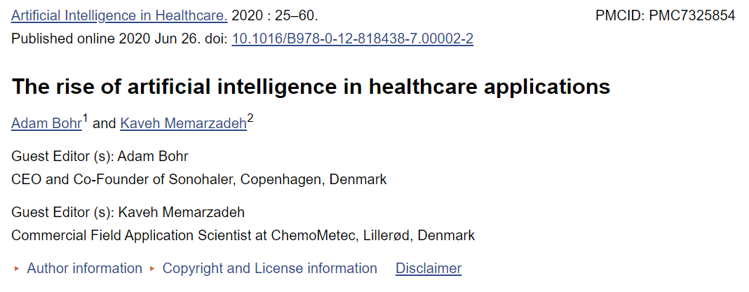


READING TIME & QUIZ: THE RISE OF AI IN HEALTHCARE APPLICATIONS
30 MINS
10 MINS
Link to Article: https://www.ncbi.nlm.nih.gov/pmc/articles/PMC7325854/

Slide 6
PROJECT OVERVIEW
EASY
ADVANCED

Slide 7
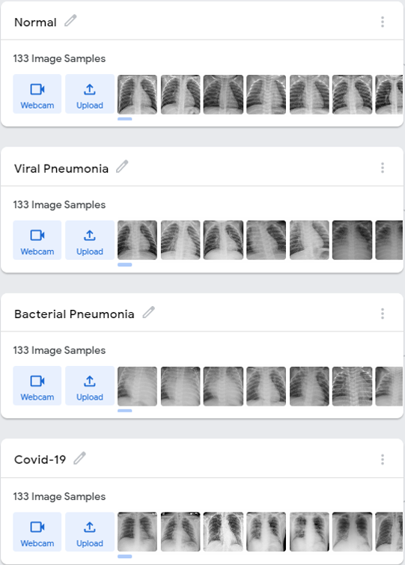
LUNG DISEASE DETECTION/CLASSIFICATION WITH AI
In this project, we will assume that you work as a consultant and you have been hired by a hospital in downtown Toronto to automate the process of detecting/classifying chest disease.
The team has collected X-Ray chest data and approached you to develop a model to detect and classify diseases in less than 1 minute. The goal is to reduce the cost and time of detection.
You have been provided with 133 images that belong to 4 classes:
Healthy
Covid-19
Bacterial Pneumonia
Viral Pneumonia
HEALTHY
COVID-19
BACTERIAL PNEUMONIA
VIRAL PNEUMONIA
AI MODEL

Slide 8
GOOGLE TEACHABLE MACHINE HANDS-ON DEMO: AI MODEL TRAINING & TESTING
EASY
ADVANCED

Slide 9
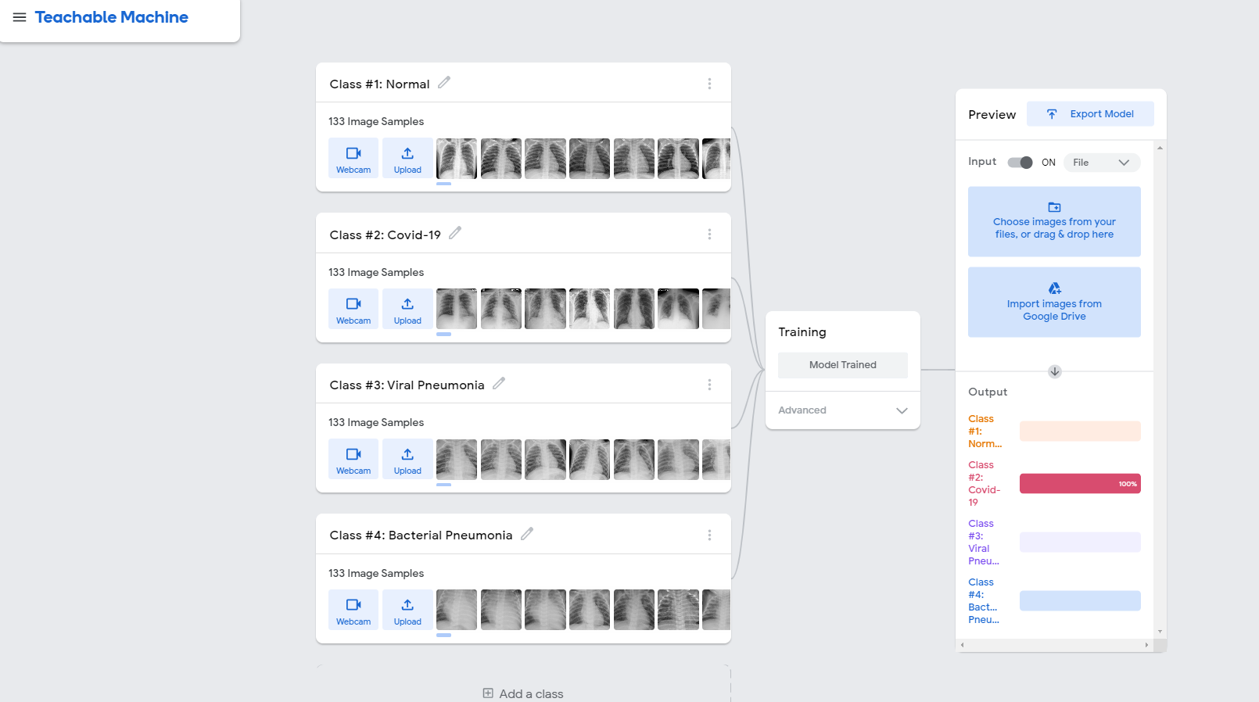
LUNG DISEASE CLASSIFICATION WITH AI: MODEL TRAINING
Try it out: https://teachablemachine.withgoogle.com/
STEP #3: TEST THE TRAINED AI MODEL
STEP #1: UPLOAD THE TRAINING DATASET
STEP #2: TRAIN THE AI MODEL

Slide 10
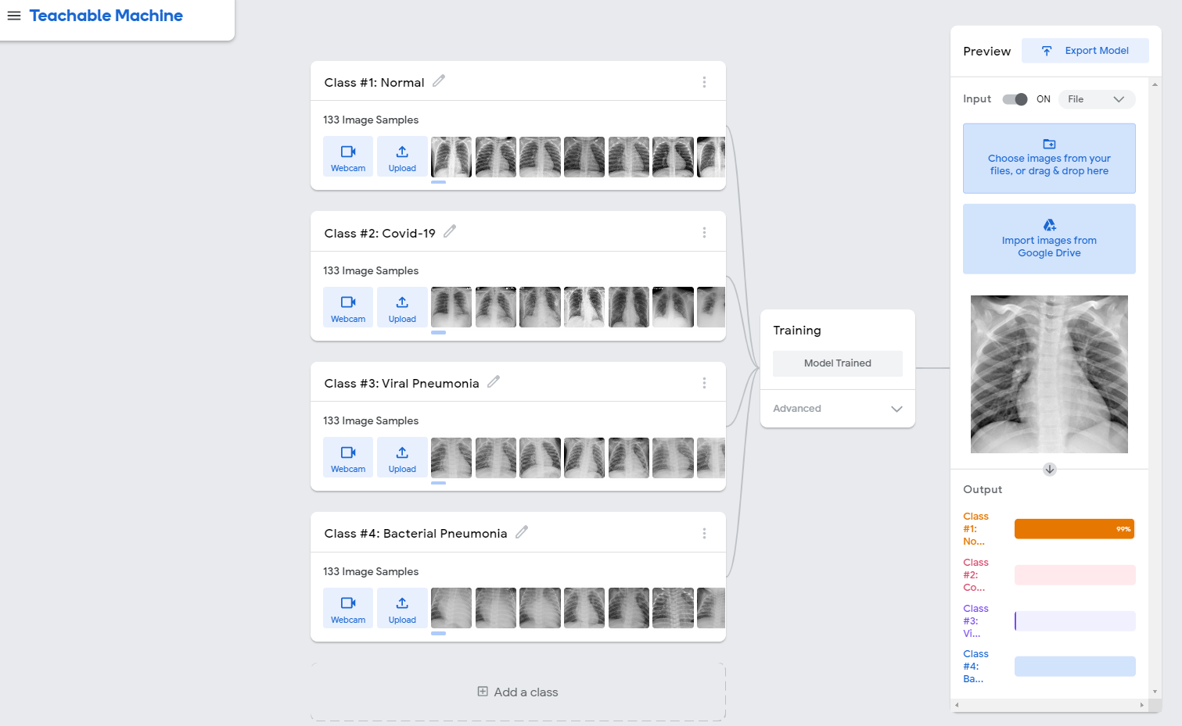
LUNG DISEASE CLASSIFICATION WITH AI: TRAINED MODEL TESTING/EVALUATION
UPLOAD AN IMAGE AND TEST THE TRAINED AI MODEL

Slide 11
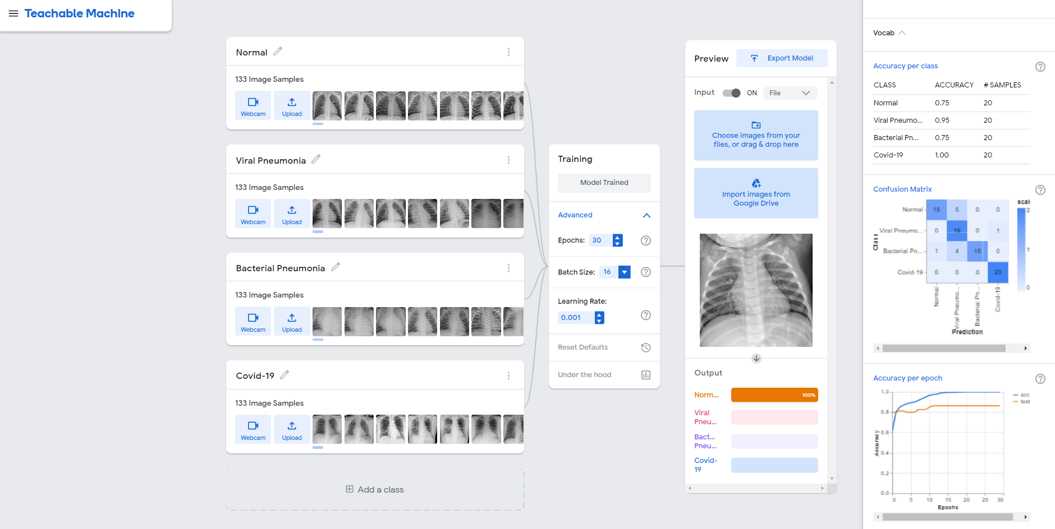
UNDER THE HOOD
WHAT IS GOING ON UNDER THE HOOD?!
WHAT DOES EPOCH MEAN? WHAT’S A BATCH SIZE?
WHAT IS LEARNING RATE? CONFUSION MATRIX? ACCURACY? DEEP LEARNING?
LET’S COVER THAT IN GREAT DETAILS NEXT

Slide 12
UNDER THE HOOD #1: ARTIFICIAL NEURAL NETWORKS, SIMPLIFIED! [TECHNICAL]
EASY
ADVANCED

Slide 13
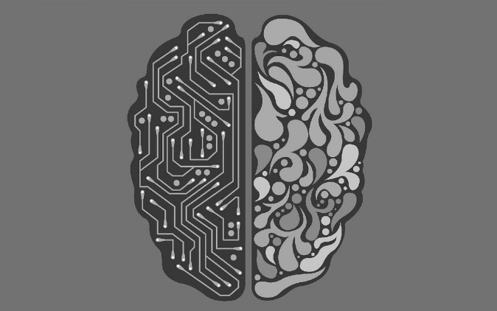
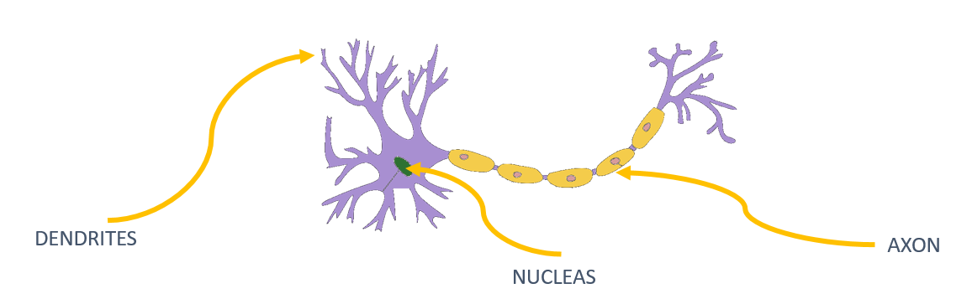
NEURON MODEL: BIOLOGICAL Vs. ARTIFICIAL
The brain has over 100 billion neurons communicating through electrical & chemical signals.
Neurons communicate with each other and help us see, think, and generate ideas. Human brain learns by creating connections among these neurons.
ANNs are information processing models inspired by the human brain.
The neuron collects signals from input channels named dendrites, processes information in its nucleus, and generates an output in a long thin branch called axon.
BIOLOGICAL NEURON
ARTIFICIAL NEURON
X1
W1
W2
NEURON
X2
W3
X3
Photo Credit: https://en.wikipedia.org/wiki/File:Neuron-no_labels2.png
Photo Credit: https://www.flickr.com/photos/alansimpsonme/34752491090

Slide 14








NEURON MATHEMATICAL MODEL: EXAMPLE
Bias allows to shift the activation function curve up or down.
Number of adjustable parameters = 4 (3 weights and 1 bias).
Activation function “F”.
b
$$X_{1}$$
$$W_{1}$$
F
$$W_{2}$$
INPUTS/INDEPENDENT VARIABLES
$$X_{2}$$
$$W_{3}$$
$$X_{3}$$
$$y=f(X_{1}W_{1}+X_{2}W_{2}+X_{3}W_{3}+b)$$

Slide 15
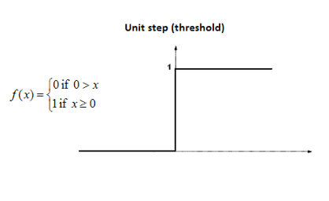











SINGLE NEURON MODEL IN ACTION!
Let’s assume an activation function of Unit Step.
The activation functions is used to map the input between (0, 1).
$$b=0$$
Input #1=1
$$X_{1}$$
$W_{1}$=0.7
$$W_{2}=0.1$$
F
$$y=1 (because 2.2>0)$$
Input #2=3
$$X_{2}$$
$$W_{3}=0.3$$
$$y=f\left(X_{1}W_{1}+X_{2}W_{2}+X_{3}W_{3}+b\right)$$
Input #3=4
$$X_{3}$$
$$y=f\left(1∗0.7+3∗0.1+4∗0.3\right)=f(2.2)$$
$$y=1 (because 2.2>0)$$

Slide 16
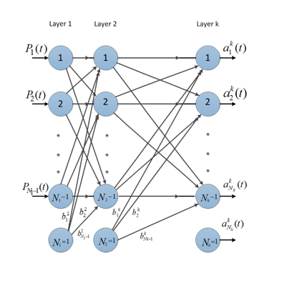


MULTI-LAYER ARTIFICAL NEURAL NETWORK
Let’s connect multiple of these neurons in a multi-layered fashion.
The more hidden layers, the more “deep” the network will get.
MATRIX OF WEIGHTS
$$\left[\begin{matrix}\begin{matrix}W_{11} & W_{12} \\ W_{21} & W_{22}\end{matrix} & ⋯ & \begin{matrix}W_{1{, N}_{1}} \\ W_{2{, N}_{1}}\end{matrix} \\ ⋮ & ⋱ & ⋮ \\ \begin{matrix}W_{m−1,1} & W_{m−1,2} \\ W_{m,1} & W_{m,2}\end{matrix} & ⋯ & \begin{matrix}W_{m−1{, N}_{1}} \\ W_{m{, N}_{1}}\end{matrix}\end{matrix}\right]$$
DURING ARTIFICIAL NEURAL NETWORKS TRAINING, OUR GOAL IS TO FIND THE OPTIMAL VALUES OF WEIGHTS
m: number of neurons in the hidden layer
$N_{1}$: number of inputs

Slide 17
MINI CHALLENGE!
GENERATIVE PRE-TRAINED TRANSFORMER 3 (GPT-3) IS A STATE OF THE ART AI MODEL THAT IS CAPABLE OF GENERATING TEXT THAT IS INDISTINGUISHABLE FROM HUMANS. HOW MANY TRAINABLE PARAMETERS ARE PRESENT IN GPT-3?
READING MATERIALS:
https://syncedreview.com/2020/05/29/openai-unveils-175-billion-parameter-gpt-3-language-model/
https://en.wikipedia.org/wiki/GPT-3#:~:text=GPT%2D3's%20full%20version%20has,of%20pre%2Dtrained%20language%20representations.

Slide 18
UNDER THE HOOD #2: HOW DO ARTIFICIAL NEURAL NETWORKS TRAIN?
EASY
ADVANCED

Slide 19
TRAINING Vs. TESTING DATASET
Data set is generally divided into 80% for training and 20% for testing (numbers may vary).
Training set: used for training the model (i.e.: weights update).
Testing set: used for testing trained network.
TRAINING DATASET
80%
TESTING DATASET
20%

Slide 20
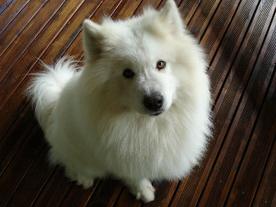


ANNs TRAINING & TESTING PROCESSES
TRAINING DATASET
Training input “X”
Predicted
Output
“$\hat{Y}$”=CAT
Desired (True) Output “Y”= DOG
Error = $\hat{Y}−Y$= CAT – DOG
Update Network Weights
Photo Credit: https://commons.wikimedia.org/wiki/File:My_dog.jpg

Slide 21



ANNs TRAINING & TESTING PROCESSES
Predicted
Output
$$\hat{Y}$$
Desired (True) Output Y
Training
inputs
X
Error = $\hat{Y}−Y$
TRAINED NETWORK WITH FROZEN WEIGHTS (INTELLIGENCE HAS BEEN CAPTURED!
STEP #1: TRAINING
Update Network Weights
Predicted
Output
$$\hat{Y}$$
Testing
inputs
X
FREEZE NETWORK WEIGHTS AND TEST THE NETWORK WITH NEW DATA THAT THE MODEL HAS NEVER SEEN BEFORE DURING TRAINING PHASE
STEP #2: TESTING

Slide 22
UNDER THE HOOD #3: AI LINGO DEMYSTIFIED!
EASY
ADVANCED

Slide 23
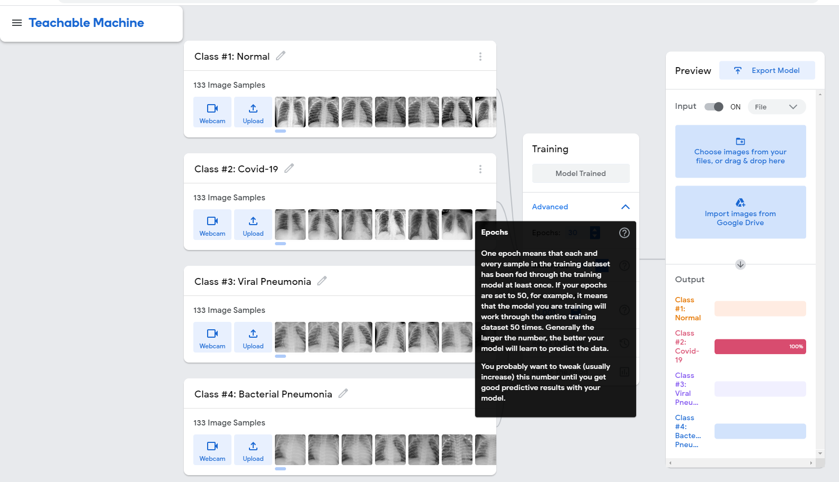
EPOCHS
Practice makes perfect!
Similar to humans, AI learns overtime and its intelligence amplifies as we continually feed the training data to it.
An Epoch means that AI has been fed with the entire dataset once.
The neural network processes the entire training dataset forward and backward through the network exactly once. The weights of the network are adjusted based on the computed errors

Slide 24
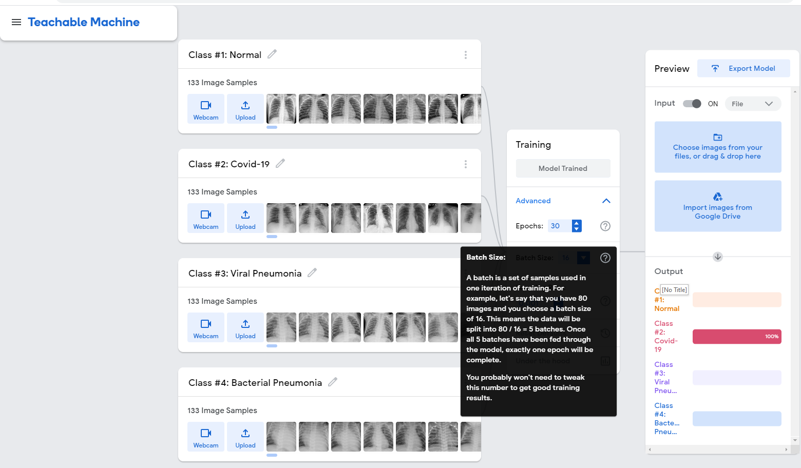
BATCH SIZE
When AI is trained, we generally don’t feed the entire dataset to the AI model due to computation and memory limitations.
Therefore, we generally breakdown the training data into smaller batches which are fed to the model individually.
An epoch contains one or more batches.
To handle large datasets efficiently, training is often done in batches rather than processing all data at once. Each batch represents a subset of the training data

Slide 25
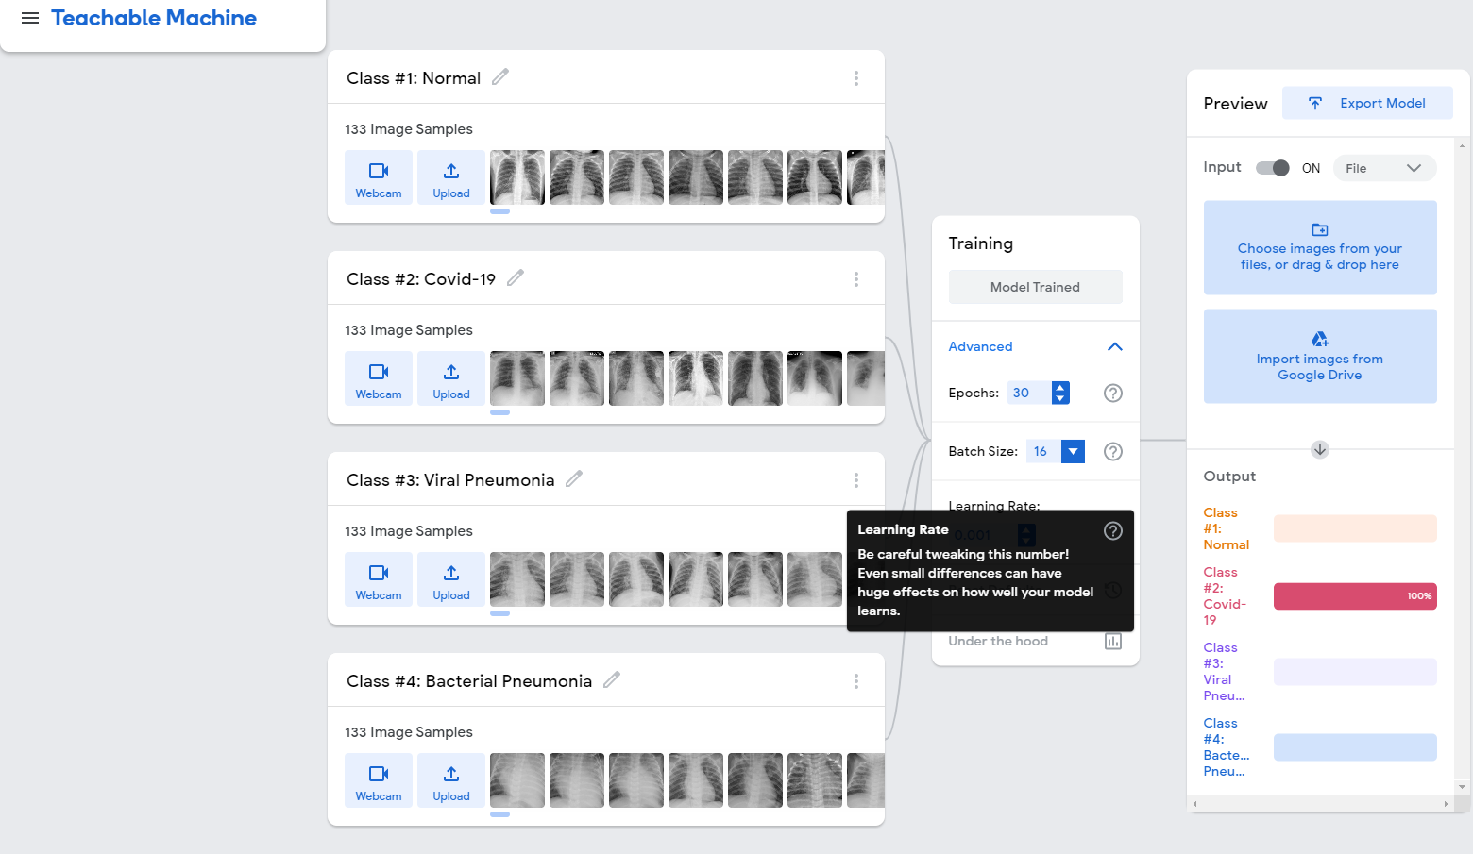
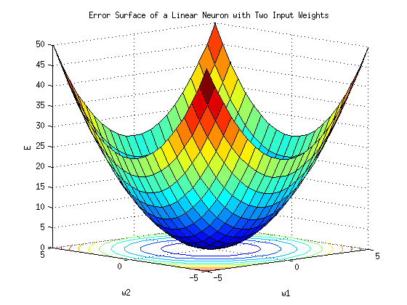
LEARNING RATE
Learning rate represents the size of the steps taken which indicates how aggressive you’d like to train the AI.
If learning rate increases, the area covered in the search space will increase so we might reach goal (global minimum) faster. However, we can overshoot the target.
For small learning rates, training will take much longer to reach optimized weight values.
The learning rate is a hyperparameter in the training of machine learning models, including those used in artificial intelligence.
https://commons.wikimedia.org/wiki/File:Error_surface_of_a_linear_neuron_with_two_input_weights.png

Slide 26
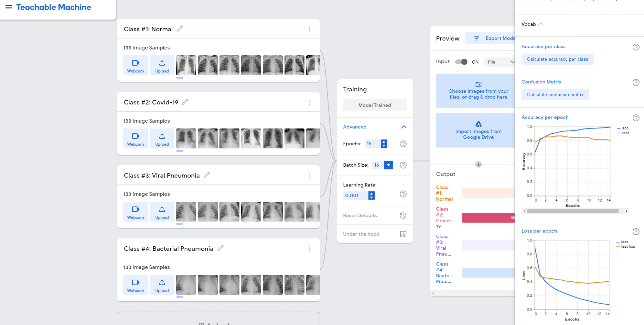
ACCURACY & LOSS
ACCURACY PROGRESSION OVER 15 EPOCHS
LOSS PROGRESSION OVER 15 EPOCHS

Slide 27
UNDER THE HOOD #4: CONFUSION MATRIX
EASY
ADVANCED

Slide 28
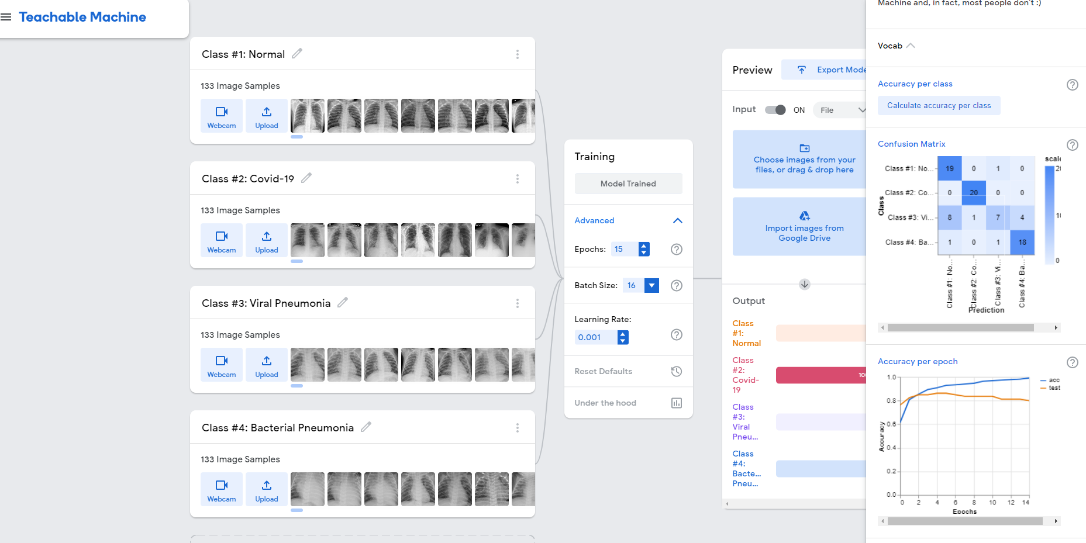
CONFUSION MATRIX IN TEACHABLE MACHINES
WHAT IS CONFUSION MATRIX?

Slide 29
CONFUSION MATRIX
TRUE CLASS
+
-
TYPE I ERROR
+
TRUE +
FALSE +
PREDICTIONS
FALSE -
TRUE -
-
TYPE II ERROR

Slide 30
CONFUSION MATRIX
A confusion matrix is used to describe the performance of a classiﬁcation model:
True positives (TP): cases when classiﬁer predicted TRUE (they have the disease), and correct class was TRUE (patient has disease).
True negatives (TN): cases when model predicted FALSE (no disease), and correct class was FALSE (patient do not have disease).
False positives (FP) (Type I error): classiﬁer predicted TRUE, but correct class was FALSE (patient did not have disease).
False negatives (FN) (Type II error): classiﬁer predicted FALSE (patient do not have disease), but they actually do have the disease
Classiﬁcation Accuracy = (TP+TN) / (TP + TN + FP + FN)
Misclassiﬁcation rate (Error Rate) = (FP + FN) / (TP + TN + FP + FN)

Slide 31
BUILD YOUR OWN ARTIFICIAL NEURAL NETWORK WITH TENSORFLOW PLAYGROUND
EASY
ADVANCED

Slide 32
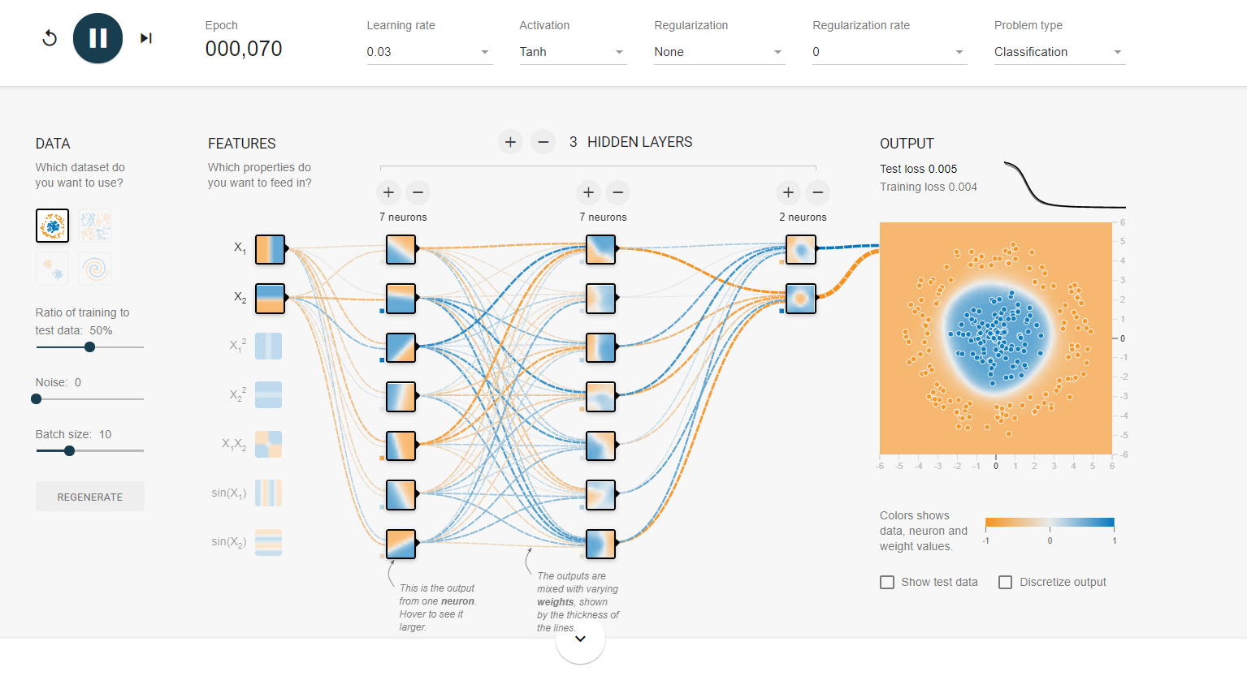
TENSORFLOW PLAYGROUND
Let’s build a neural network here: https://playground.tensorflow.org/

Slide 33

MINI CHALLENGE
Choose the most challenging dataset (spiral) and train the model
Change the architecture of the model by adding new hidden layers, neurons and changing activation functions
Tune the model hyperparameters such as learning rate and regularization to achieve better model performance.
Perform feature engineering to improve model performance
spiral dataset" usually refers to a synthetic dataset with a distinctive spiral pattern. This type of dataset is often used as a more challenging example for classification tasks, especially when the classes are not linearly separable.
A typical spiral dataset consists of points that are arranged in a spiral shape, with multiple turns.
Structure: The dataset is generated in such a way that the points form a spiral pattern in two-dimensional space (X and Y coordinates).
Classes: Usually, there are two classes of points in the spiral dataset, and the challenge is to train a model that can accurately separate these classes.
Complexity: The spiral dataset is considered more complex than linearly separable datasets (like a simple circle or straight line) because the decision boundary needed to separate the classes is nonlinear.
Using a spiral dataset in machine learning taskstest the model's ability to capture intricate patterns and make nonlinear decisions.
https://developers.google.com/machine-learning/crash-course/DPE/tp-ss-neural-net-intro-spiral

Slide 34
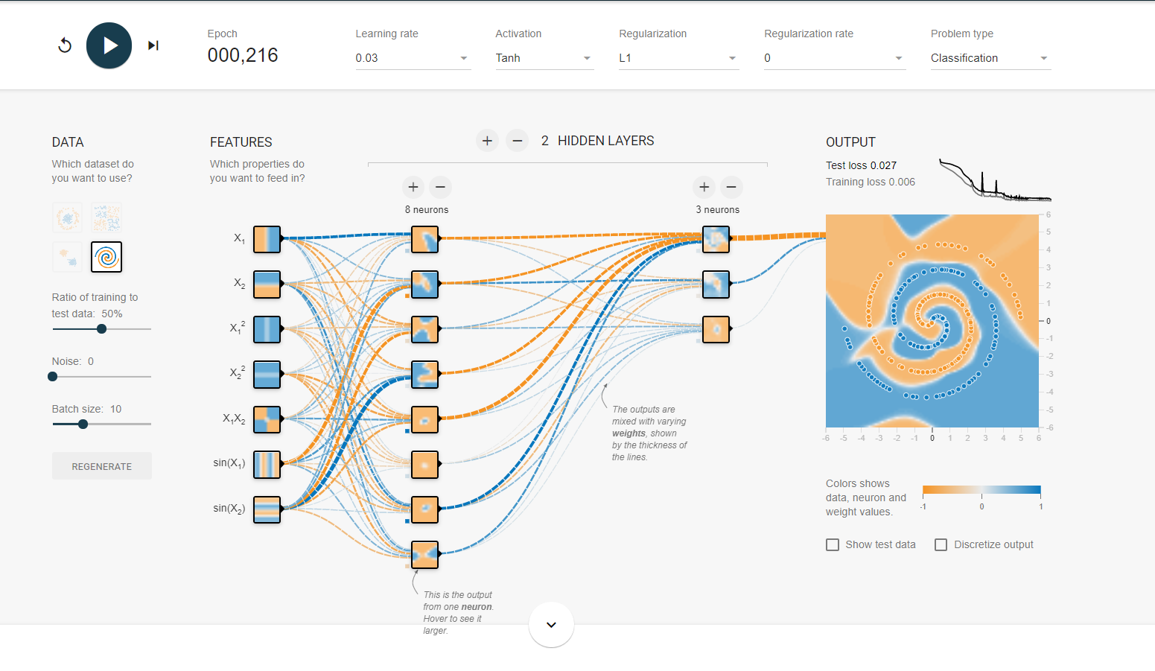
MINI CHALLENGE SOLUTION

Slide 35
EXPORT, SAVE AND DEPLOY THE MODEL
EASY
ADVANCED

Slide 36
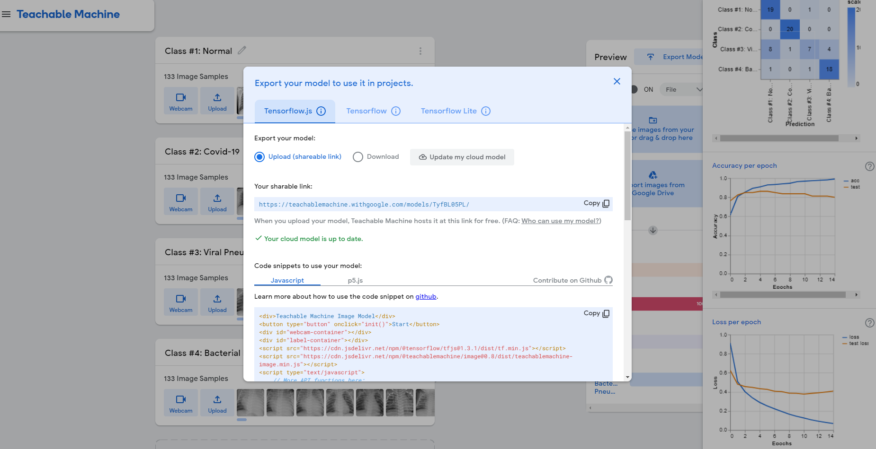
EXPORT, SAVE AND DEPLOY THE MODEL

Slide 37
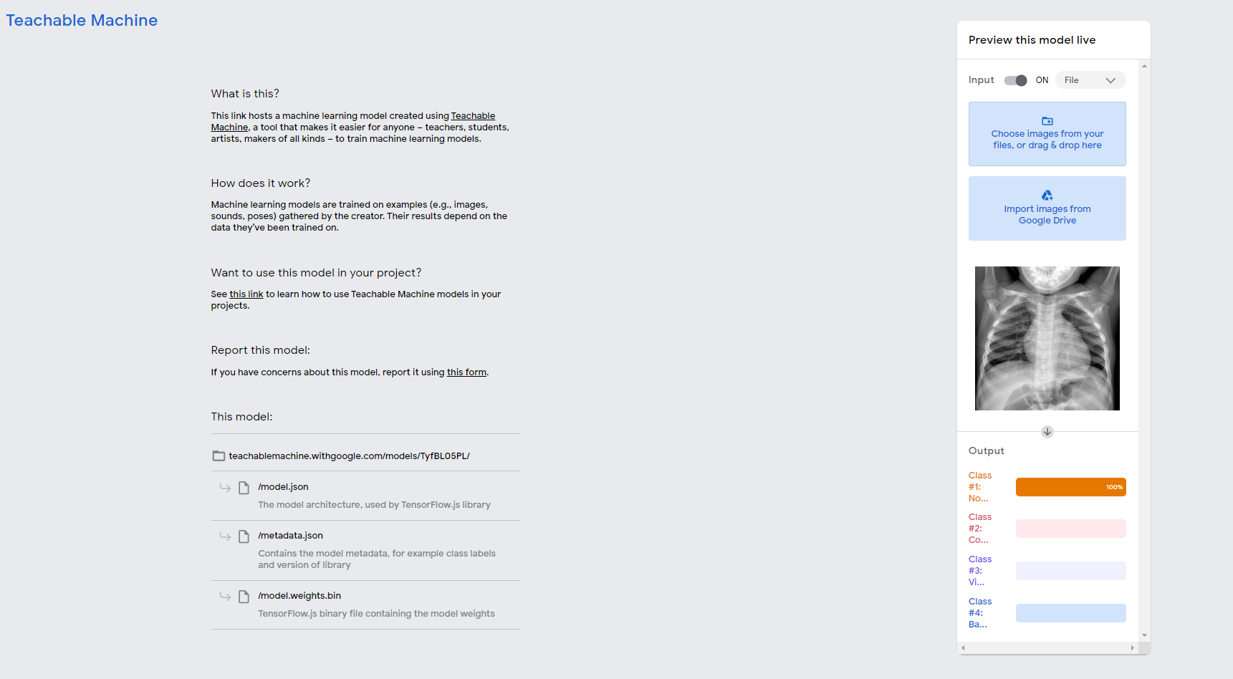
EXPORT, SAVE AND DEPLOY THE MODEL

Slide 38
CONVOLUTIONAL NEURAL NETWORKS (CNNs)
EASY
ADVANCED

Slide 39
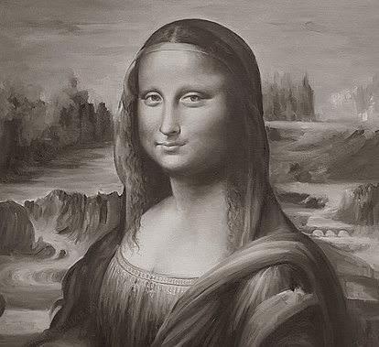
WHAT IS AN IMAGE?
A greyscale image is system of 256 tones with values ranging from 0-255.
'0' represents black and '255' represents white.
Numbers in-between represents greys between black and white.
Binary systems use digits '0' and '1‘ where '00000000' for black, to '11111111' for white (8-bit image).
Note: binary value of '11111111' is equal to decimal value of '255‘.
255 | 255 | 255
155 | 155 | 155
0 | 0 | 0
11111111 | 11111111 | 11111111
10011011 | 10011011 | 10011011
00000000 | 00000000 | 00000000
Photo Credit: https://commons.wikimedia.org/wiki/file:monalisa_in_antique_color-oil_painting_by_rajasekharan.jpg

Slide 40

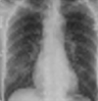
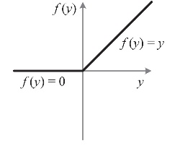
CONVOLUTIONAL NEURAL NETWORKS: ENTIRE NETWORK OVERVIEW
OUTPUT
INPUT
CONVOLUTION
POOLING
FLATTENING
HEALTHY
COVID-19
VIRAL
BACTERIAL
KERNELS/
FEATURE DETECTORS
POOLING FILTERS
CONVOLUTIONAL LAYER
POOLING LAYER (DOWNSAMPLING)
Photo Credit: https://commons.wikimedia.org/wiki/File:Artificial_neural_network.svg

Slide 41
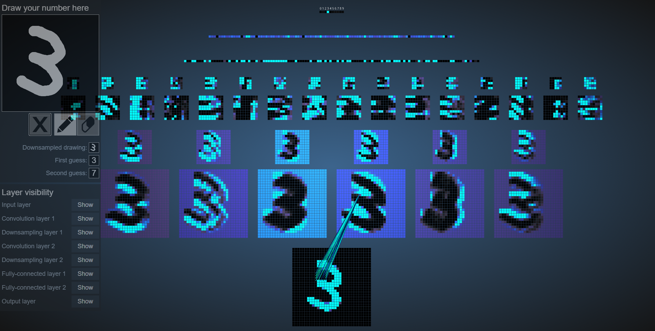
CONVOLUTIONAL NEURAL NETWORKS IN ACTION!
https://adamharley.com/nn_vis/mlp/3d.html

Slide 42
MINI CHALLENGE
Using the 2D CNN data visualization link below, experiment with at least 5 numbers and assess the performance of trained model: https://www.cs.ryerson.ca/~aharley/vis/conv/flat.html
Use 3D CNN visualization instead of 2D, try at least 5 numbers, and assess model performance: https://www.cs.ryerson.ca/~aharley/vis/conv/

Slide 43
CONVOLUTIONAL NEURAL NETWORKS (CNNs) DEEP DIVE
EASY
ADVANCED

Slide 44

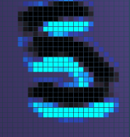

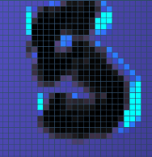
FEATURE DETECTORS
Convolutions use a kernel matrix to scan a given image and apply a filter to obtain a certain effect.
An image Kernel is a matrix used to apply effects such as blurring and sharpening.
Kernels are used in machine learning for feature extraction to select most important pixels of an image.
Convolution preserves the spatial relationship between pixels.
FEATURE MAPS
KERNELS/
FEATURE DETECTORS

Slide 45
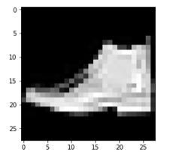
FEATURE DETECTORS
Live Convolution: http://setosa.io/ev/image-kernels/
FEATURE DETECTOR
0 | 1 | 1 | 0 | 1
1 | 0 | 0 | 0 | 1
1 | 1 | 0 | 0 | 0
0 | 1 | 1 | 1 | 0
0 | 0 | 1 | 0 | 1
1 | 0 | 0
0 | 1 | 0
0 | 1 | 0
1
1
1
3
1
1
2
3
1
FEATURE MAP
IMAGE

Slide 46

RELU (RECTIFIED LINEAR UNITS)
RELU Layers are used to add non-linearity in the feature map.
It also enhances the sparsity or how scattered the feature map is.
INPUT
INPUT
CONVOLUTION
POOLING
FLATTENING
HEALTHY
COVID-19
VIRAL
BACTERIAL
KERNELS/
FEATURE DETECTORS
POOLING FILTERS
CONVOLUTIONAL LAYER
POOLING LAYER (DOWNSAMPLING)
Photo Credit: https://commons.wikimedia.org/wiki/File:Artificial_neural_network.svg

Slide 47


RELU (RECTIFIED LINEAR UNITS)
RELU Layers are used to add non-linearity in the feature map.
It also enhances the sparsity or how scattered the feature map is.
The gradient of the RELU does not vanish as we increase x compared to the sigmoid function
7 | 10 | -5 | 2 | 1
1 | 0 | 2 | 3 | -6
1 | 17 | -5 | 0 | 0
0 | 1 | 1 | 1 | 0
0 | 0 | -8 | 12 | 1
7 | 10 | 0 | 2 | 1
1 | 0 | 2 | 3 | 0
1 | 17 | 0 | 0 | 0
0 | 1 | 1 | 1 | 0
0 | 0 | 0 | 12 | 1
Photo Credit: https://commons.wikimedia.org/wiki/File:Artificial_neural_network.svg

Slide 48
POOLING (DOWNSAMPLING)
Pooling or down sampling layers are placed after convolutional layers to reduce feature map dimensionality.
This improves the computational efficiency while preserving the features.
Pooling helps the model to generalize by avoiding overfitting.
If one of the pixel is shifted, the pooled feature map will still be the same.
Max pooling works by retaining the maximum feature response within a given sample size in a feature map.
Live illustration : http://scs.ryerson.ca/~aharley/vis/conv/flat.html
1 | 1 | 3 | 4
3 | 6 | 2 | 8
3 | 9 | 1 | 0
1 | 3 | 3 | 4
6
MAX POOLING
6
8
FLATTENING
8
9
4
9
2x2
STRIDE = 2
4
Photo Credit: https://commons.wikimedia.org/wiki/File:Artificial_neural_network.svg

Slide 49
READING TIME & QUIZ: CONVOLUTIONAL NEURAL NETWORKS
Link to Article: https://www.ncbi.nlm.nih.gov/pmc/articles/PMC7325854/
Read section 2.3.2 entitled “Deep Learning and Medical Image Recognition” and answer the following quiz
20 MINS
10 MINS

Slide 50
COVID-NET
EASY
ADVANCED

Slide 51
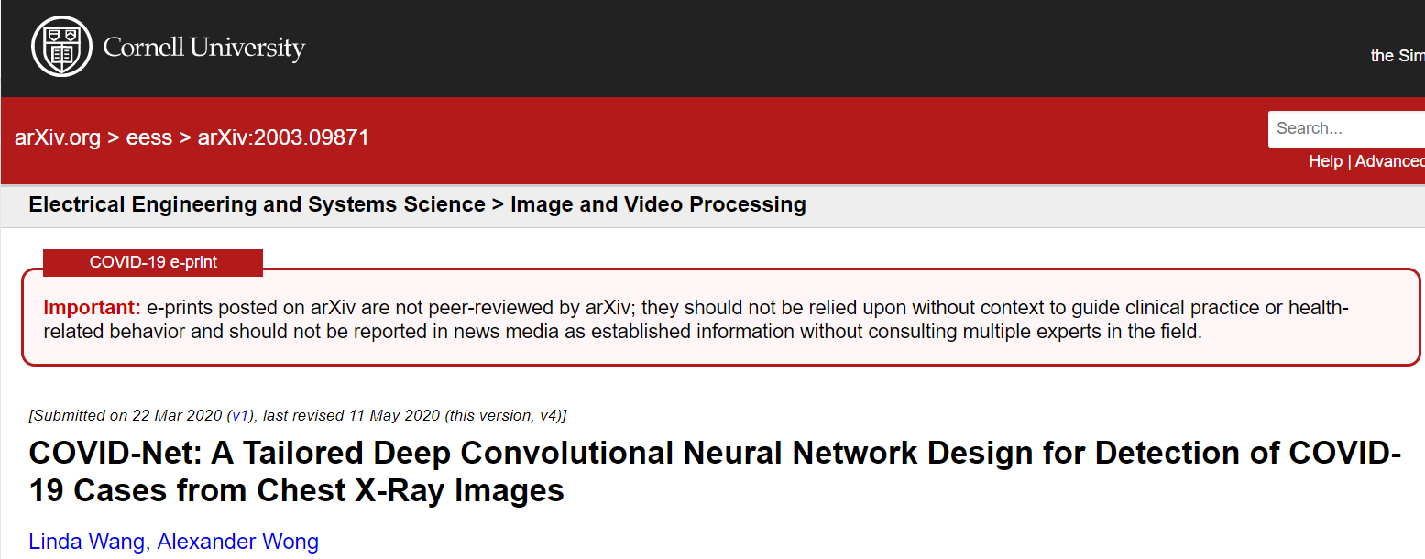
READING TIME & QUIZ: COVID-NET
Read the paper below (abstract and conclusion are sufficient) and answer the next quiz.
10 MINS
10 MINS
Link to paper: https://arxiv.org/pdf/2003.09871.pdf

